Slide 1
ECE 428 Programmable ASIC Design
FPGAs in DSP Applications
Haibo Wang
ECE Department
Southern Illinois University
Carbondale, IL 62901

Slide 2
Overview
Motivation
Digital Signal Processing (DSP) is one of the most active area in VLSI applications
Traditionally, DSP algorithms are implemented either using general purpose DSP
processors (Low speed, less expensive, flexible) or using ASICs (High speed,
expensive, less flexible)
FPGAs provide solutions that maintain both the advantages of the approach based
on DSP processors and the approach based on ASICs
Outline
Number Systems
Fixed-Point Number System
Floating-Point Number System
VLSI Architectures for DSP Circuits
Distributed Arithmetic Circuits

Slide 3
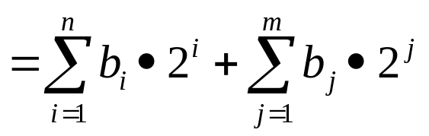
Fixed-Point Number System
Binary number representation of fixed-point numbers
“Binary point”
b_{n} b_{n-1} b_{n-2} ••• b₀ b₋₁ b₋₂ ••• b_{-m}
Examples:
Binary
Decimal
Decimal
Binary
101.0101 5.3125
1.25 1.01
000.011 0.375
1.24 1.001111010•••
If the binary number can have 8 bits for fractional part, we can use
1.00111101 (1.23828125) to approximate 1.24
If the binary number can have 7 bits for fractional part, we can use
1.0011111 (1.2421875) to approximate 1.24

Slide 4
Arithmetic Operations for Fixed-Point Numbers
Add/Subtract
b_{n} b_{n-1} b_{n-2} ••• b₀ b₋₁ b₋₂ ••• b_{-m}
B
+/-
a_{n} a_{n-1} a_{n-2} ••• a₀ a₋₁ a₋₂ ••• a_{-m}
A
c
s_{n} s_{n-1} s_{n-2} ••• s₀ s₋₁ s₋₂ ••• s_{-m}
S
The addition or subtraction of two fixed-point numbers can be performed by
regular adder or subtracter if the “binary points” of the two numbers are aligned.
The “binary point” remains the same position in the resulted number.
B
+/-
S
A

Slide 5
Arithmetic Operations for Fixed-Point Numbers
Multiplication
×
n - k bits
k bits
m - l bits
l bits
=
n+m-k-l bits
k+l bits
For the convenience of hardware implementation, we prefer to have the product
of a multiplication keeping the same length as the multiplicand or the multiplier
(assume they have the same length). To achieve this, we normally truncate
the least significant bits of the product.
Arithmetic operation with fixed word-length
n
n
×
n
×
n
n
n
n

Slide 6
Arithmetic Operations for Fixed-Point Numbers
Normalized fixed-point numbers
Scaling all the numbers involved in computation by a factor K such that all the
numbers are within the range from 0 to 1
Fixed-point number after normalization
n bits
Addition/Subtraction
n bits
+/-
n bits
=
n bits
Addition/Subtraction
n bits
×
n bits
=
n bits
n bits
truncated

Slide 7
Representation of Negative Numbers
Signed-magnitude numbers
S
Normalized magnitude
Sign bit: 0 for positive number and 1 for negative number
2’s complementary numbers
S
Normalized 2’s complementary number
Sign bit: 0 for positive number and 1 for negative number

Slide 8
Floating-Point Numbers
Scientific Notation
6.02 x 10²³
decimal point
radix (base)
Binary Floating-Point Numbers
Mantissa
1.0_{two} x 2⁻¹
“binary point”
radix (base)

Slide 9
Floating-Point Representation
Normal format: +1.xxxxxxxxxx_{two}*2^{yyyytwo}
S
Exponent
Significand
S represents Sign
- (1 for negative number and 0 for positive number)
Exponent represents yyyy
- (It is a biased number, is is also called as excess-bias number. E.g. if a number A is a excess-8 coding, the real value of the number is A-8)
Significand represents xxxxxxxxx
(-1)^{S} * (1 + Significand) * 2^{(Exponent - Bias)}

Slide 10




Arithmetic Operations of Floating-Point Numbers
Assume number
Addition/Subtraction:
Where X_{E} < Y_{E}
Compute Y_{E}-X_{E}, a fixed-point subtraction
Right shift X_{M} by Y_{E}-X_{E} bits to obtain X_{M}•2^{Xe-Ye}
Compute X_{M}•2^{Xe-Ye}±Y_{M}, a fixed-point addition or subtraction
Multiplication:
Compute X_{M}•Y_{M}, a fixed-point multiplication
Compute X_{E}+Y_{E}, a fixed-point addition

Slide 11
DSP Applications
Common DSP Functions that are implemented using VLSIs
Filters (FIR, IIR)
Fast Fourier Transform (FFT)
Direct Cosine Transform (DCT)
Encoder/decoder and error correction/detection functions
• • • • •
FIR (Finite Impulse Response) Filter
Y[n] is the output at nth clock cycle; X[n] is the input at nth clock cycle
a₀, a₁, ….. a_{k-1} are filter coefficients
IIR (Infinite Impulse Response) Filter

Slide 12
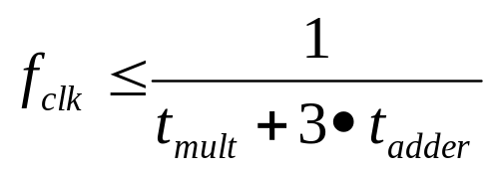
FIR Filter Implementation
Example:
Tap
This is a 4-tap FIR filter
Canonic form implementation:
x[n]
D
D
D
a₀
×
a₁
×
a₂
×
a₃
×
y[n]
+
+
+
Clock frequency

Slide 13
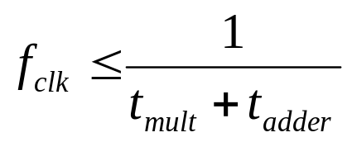
FIR Filter Implementation
Pipelined implementation 1:
x[n]
D
D
D
D
D
D
a₀
×
a₁
×
a₂
×
a₃
×
y[n-3]
D
+
D
+
D
+
Clock frequency

Slide 14
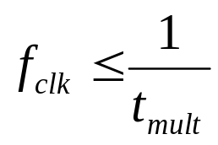
FIR Filter Implementation
Pipelined implementation 2:
x[n]
D
D
D
D
D
a₀
×
a₁
×
a₂
×
a₃
×
D
D
D
y[n-3]
D
+
D
+
D
+
Clock frequency
(assume t_{mult} > t_{add})

Slide 15
FIR Filter Implementation
Pipelined implementation 3 (inverted form):
x[n]
a₃
×
a₂
×
a₁
×
a₀
×
y[n]
D
+
D
+
D
+
Clock frequency

Slide 16
FIR Filter Implementation
Pipelined implementation 4:
x[n]
a₃
×
a₂
×
a₁
×
a₀
×
D
D
D
D
y[n-1]
D
+
D
+
D
+
Clock frequency
(assume t_{mult} > t_{add})

Slide 17
FIR Filter Implementation
Pipelined implementation 5:
x[n]
D
D
D
a₀
×
a₁
×
a₂
×
a₃
×
D
D
D
D
+
+
D
D
+
(assume t_{mult} > t_{add})
y[n-2]
Difficult to layout

Slide 18
FIR Filter Implementation
Parallel implementation 1:
+
D
+
+
y[n+1]
×
×
×
×
a₂
a₃
a₀
a₁
x[n+3]
x[n+1]
x[n+2]
x[n]
x[n-1]
D
×
×
×
×
a₂
a₃
a₀
a₁
+
D
+
+
y[n]

Slide 19
FIR Filter Implementation
Parallel implementation 2:
+
D
+
+
y[n-1]
D
D
D
D
×
×
×
×
a₂
a₃
a₀
a₁
x[n+3]
x[n+1]
x[n+2]
x[n]
x[n-1]
D
×
×
×
×
a₂
a₃
a₀
a₁
D
D
D
D
If t_{mult} > t_{adder}
+
D
+
+
y[n-2]

Slide 20
FIR Filter Implementation
Parallel implementation 3:
+
D
+
D
+
y[n-5]
D
D
D
D
×
×
×
×
a₀
a₁
a₂
a₃
x[n+3]
x[n+1]
D
D
D
D
x[n+2]
x[n]
D
D
D
×
×
×
×
a₀
a₁
a₂
a₃
D
D
D
D
+
D
+
D
+
y[n-6]

Slide 21
FIR Filter Implementation
Serial implementation:
x[n-1]
x[n-2]
x[n-3]
x[n]
a₀
a₁
×
a₂
a₃
D
Multiplier accumulator (MAC)
+
D
y[n]

Slide 22
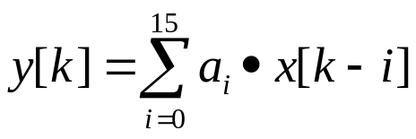
FIR Filter Implementation
Implementation of FIR filters with large number of taps
Examples: implementation of a 16-tap FIR filter
X_{k-12} a₁₂
X_{k-8} a₈
X_{k-4} a₄
X_{k} a₀
X_{k-13} a₁₃
X_{k-9} a₉
X_{k-5} a₅
X_{k-1} a₁
X_{k-14} a₁₄
X_{k-10} a₁₀
X_{k-6} a₆
X_{k-2} a₂
X_{k-15} a₁₅
X_{k-11} a₁₁
X_{k-7} a₇
X_{k-3} a₃
×
×
×
×
D
D
D
D
+
+
D
D
+
D
+
D

Slide 23
IIR Filter Implementation
Example:
Direct Implementation:
x[n]
D
D
D
b₀
×
b₁
×
a₂
×
a₁
×
+
+
+
y[n]
Clock frequency

Slide 24
IIR Filter Implementation
Pipelined Implementation 1:
x[n]
D
b₀
×
b₁
×
a₂
×
a₁
×
D
D
D
D
+
D
+
D
+
y[n-3]
Clock frequency
(assume t_{mult} > t_{add})

Slide 25
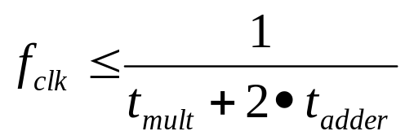
IIR Filter Implementation
Pipelined Implementation 2:
x[n]
b₀
×
y[n-1]
+
D
+
D
a₁
b₁
+
×
×
D
a₂
×

Slide 26
LUT-Based Multiplier
In many DSP circuits, multipliers always have one constant input.
C_{i} (constant)
x[n]
×
y[n]
For the above multiplier, y[n] purely depends on x[n]. Thus,
a look-up table (LUT) can be used to implement the multiplier
For example, a 256×16 bit memory
can be used to implement a 8-bit
multiplier if one of its input is
always constant.
address
X[n]
y[n]
• • •

Slide 27
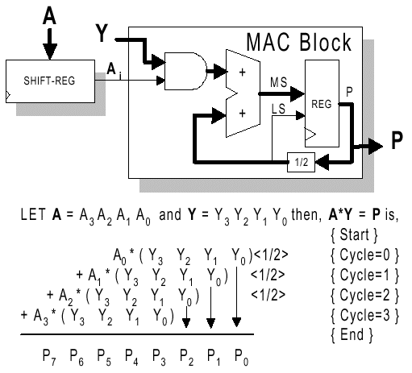
Distributed Arithmetic
Multiplication by using shift-and-add technique

Slide 28
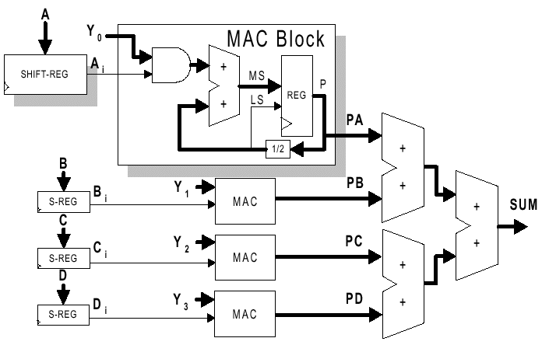
Distributed Arithmetic
Calculate A•Y₀ + B•Y₁ + C•Y₂ + D•Y₃

Slide 29
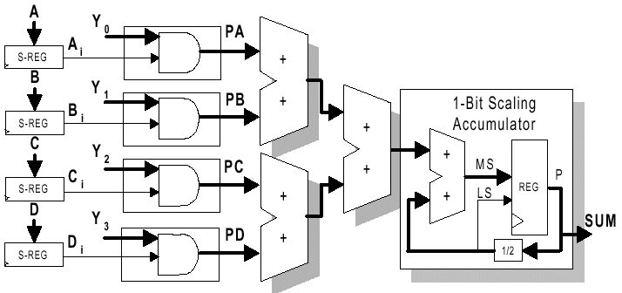
Distributed Arithmetic
Serial Distributed Arithmetic for Computing A•Y₀ + B•Y₁ + C•Y₂ + D•Y₃

Slide 30
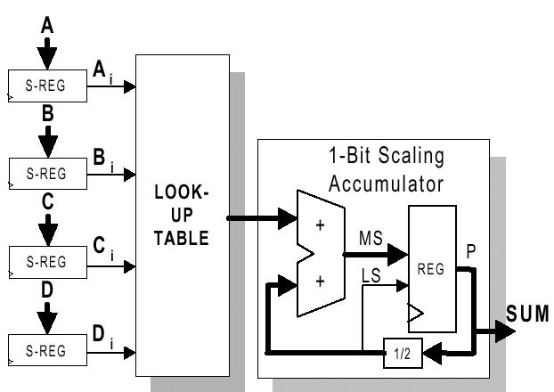
Distributed Arithmetic
LUT-Based SDA for Computing A•Y₀ + B•Y₁ + C•Y₂ + D•Y₃

Slide 31
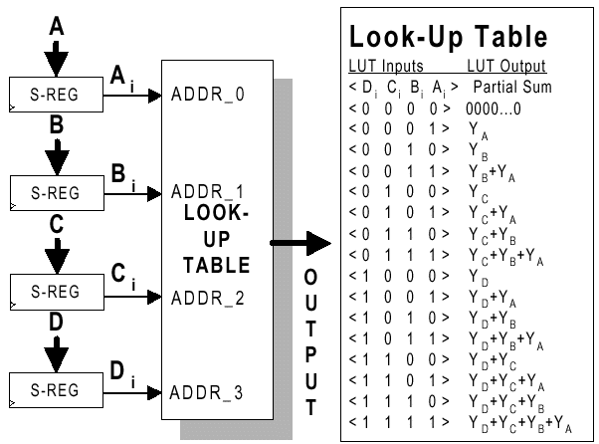
Distributed Arithmetic
LUT Technique for Distributed Arithmetic

Slide 32
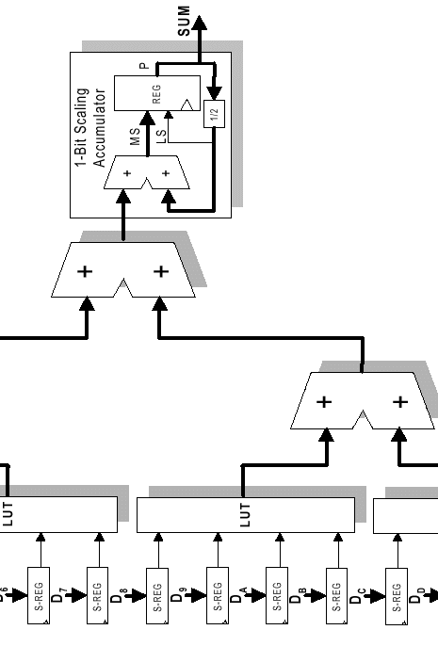
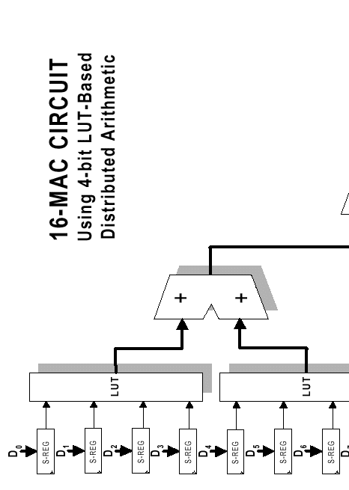
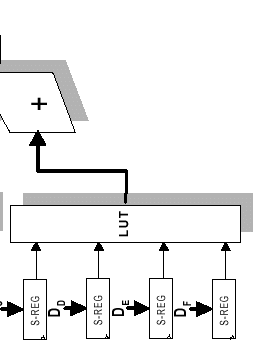
Distributed Arithmetic
SDA 16-MAC Circuit

Slide 33
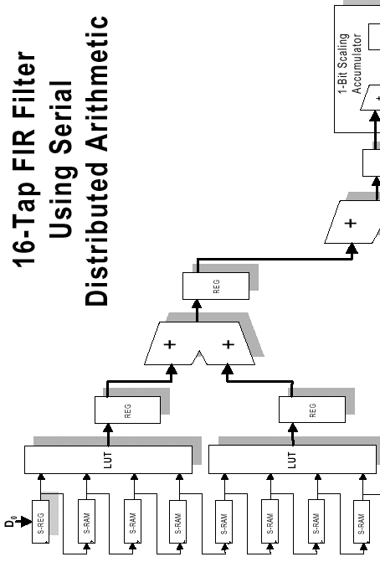
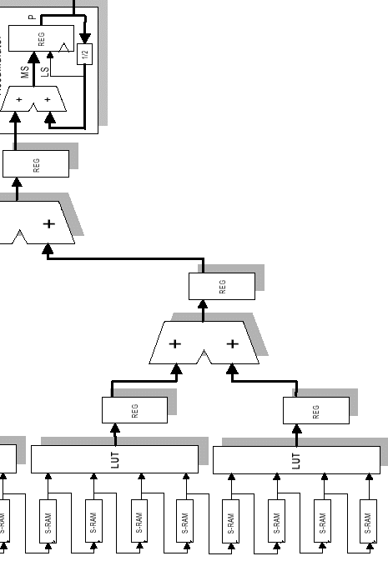
Distributed Arithmetic
SDA 16-Tap FIR Filter

Slide 34
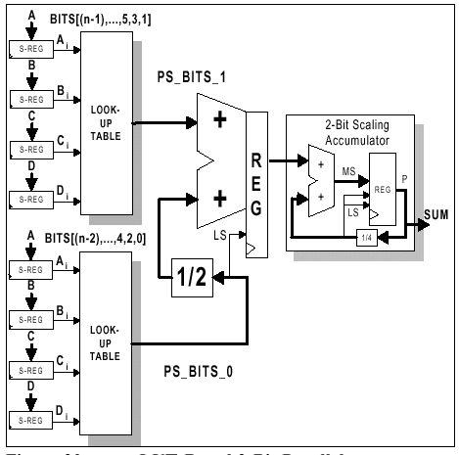
Parallel Distributed Arithmetic

